Slide 1
AIML CA1
Regression

Slide 2
Table of contents
01
02
03
04
Data Preprocessing
EDA
Model Selection
Model Improvement

Slide 3
01
EDA Explanatory data analysis

Slide 4
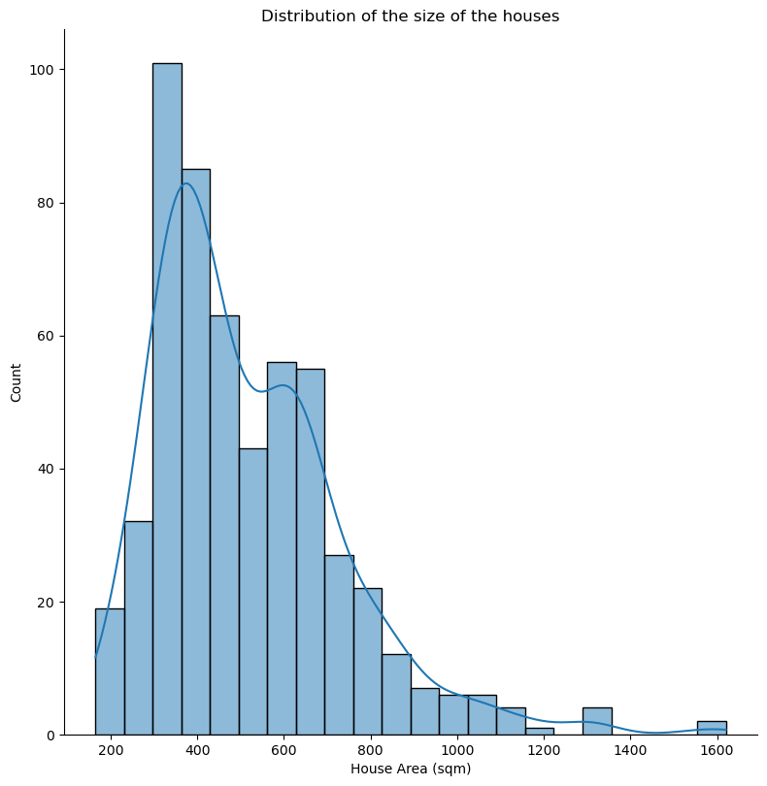
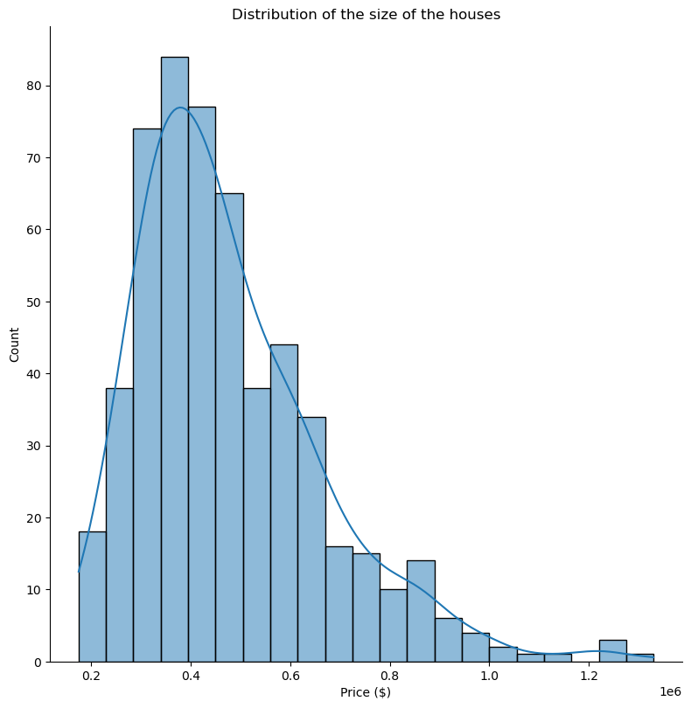
EDA Univariate
From the 2 graphs to the right its clear to say that our data is quite skewed prompting us to do standardization later.

Slide 5
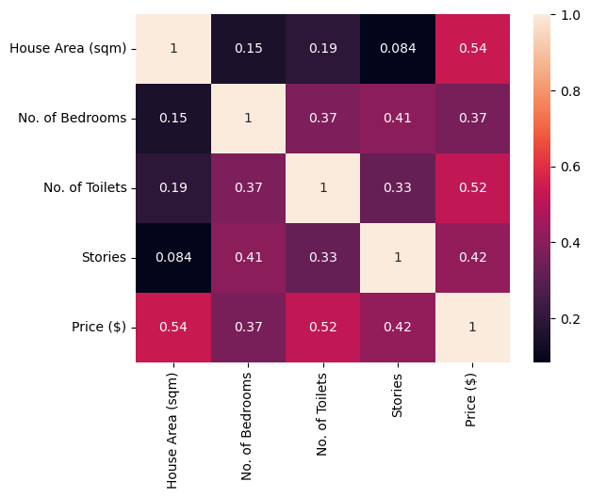
EDA Bivariate
When plotting out the correlation matrix I see that some features has an extremely weak correlation being as low as 0.084 while some has moderate correlation being around 0.41, this anomaly prompts me to check for multicollinearity
The Presence of multicollinearity might cause our model to not work as expected hence I performed checks and finally made sure our data set is not multicollinear

Slide 6
02
Data Preprocessing

Slide 7
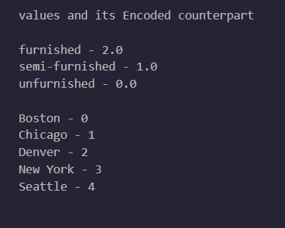
Data Preprocessing Encoding
For this encoding I used 2 different encoders, Ordinal encoder for Renovation Status, and label encoders for city,
The reason I used ordinal encoder is because I believe Renovation Status to be in order from unfurnished ->
Semi-furnished -> furnished hence I encoded It using ordinal encoder instead of any other encoder
Since City is just a normal category feature, I just used label encoder to encoded the city to the values you see on the left

Slide 8
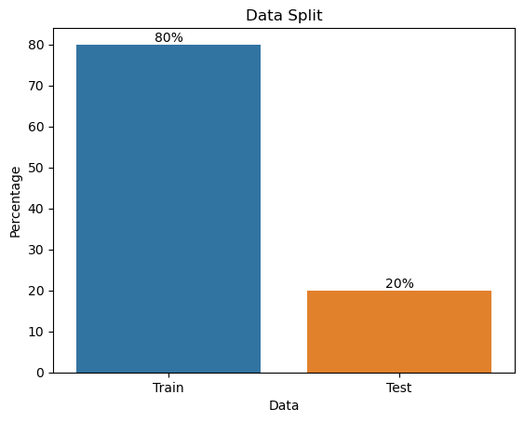
Data Preprocessing Feature Selection
- Just like most machine learning projects I started off with a 80-20 split of data with 80% of data for training the model and 20% of testing data that was not passed through the model while training and is used to evaluate the model’s performance

Slide 9
Data Preprocessing Standardization
- Standard Scaler
- Log Transformation
- For this project I know I had to do some form of standardization, but I didn’t know which one would best fit my situation the best so I applied the basic standard scaler first and during model improvement I will evaluate which standardizer is best for me
- Robust Scaler
- No Scaler

Slide 10
03
Model Selection

Slide 11
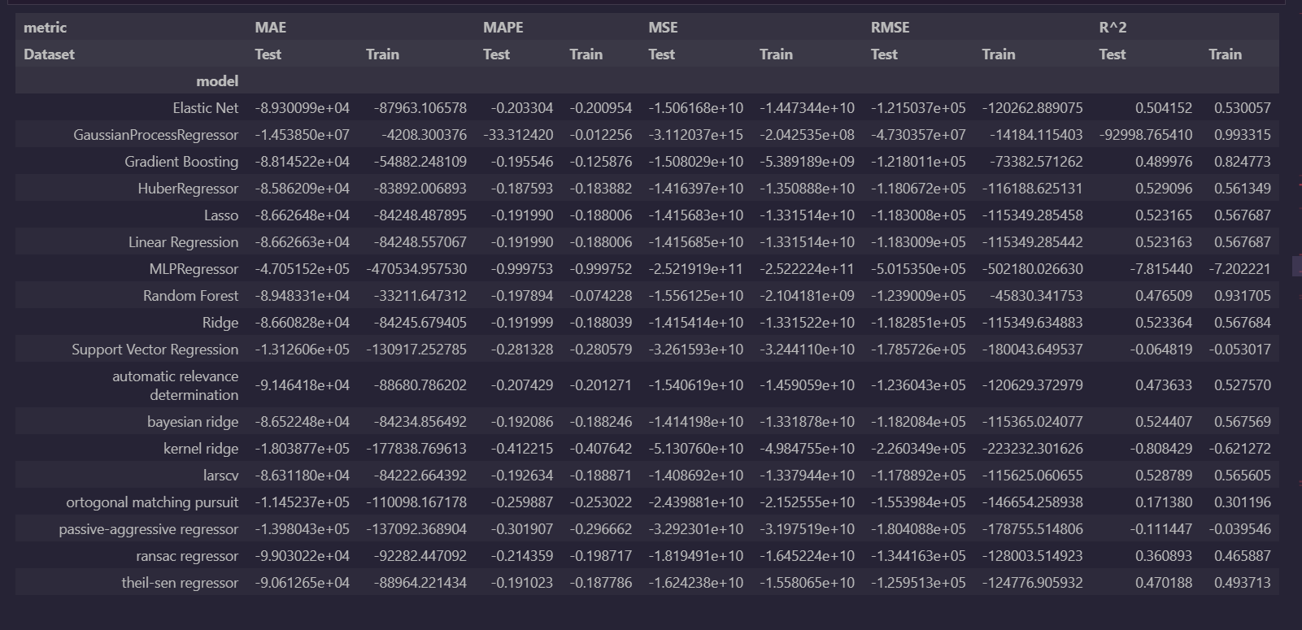
Model Selection

Slide 12
Data Selection
I decided that for this project I will be focusing MAE score above others as it’s the easiest to interpret and compare with other models
With that in mind I look at the top few models in terms of MAE and realise that their scores are really close to each other, so I decided to do further model selection with 5 models I selected, The 5 models being
- Huber Regressor
- LarsCV
- Bayesian Ridge
- Ridge
- Lasso
- Baseline model (we compare all models to baseline too)

Slide 13
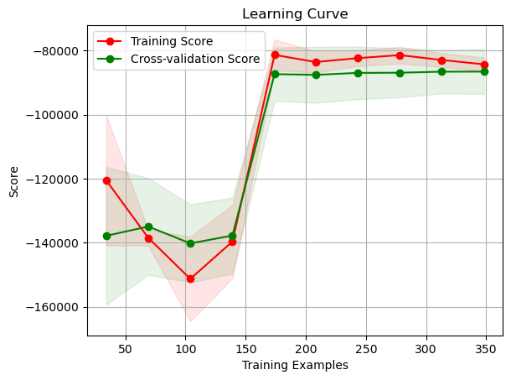
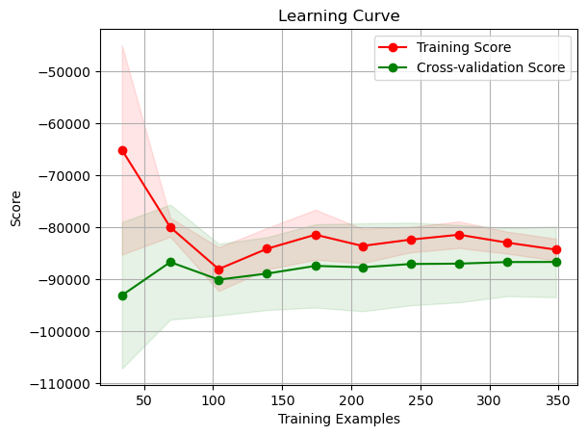
Data Selection
Most of my model’s learning curve looks like 1 of the 2 images about, probably because their mae scores are so similar hence their learning curve looks quite identical as well, but for obvious reasons I decided to eliminate the one one the left as overall the right learning curve is just much better, having a better shape and a better score

Slide 14
Data Selection
Since more than 1 model’s learning curve looks like this we can’t possibly choose that many so lets bring that number down, here are some models that I drop and why:
LarsCV, LarsCV is primarily knows as a feature selector which is not really what I want
Lasso, Lasso focuses more on MSE, which doesn’t fit my background as I am evaluating based on MAE

Slide 15
Models Selected
Huber Regressor
Ridge
Stacked
Ridge + Huber
Huber Regressor is good for our case since it is less affected by outliers compared to other models making standardization less needed
Ridge is a good model because it allows us to do regularization if we wanted to which may improve the results
Since both models are so close in terms of results, I decided to create a new model by stacking them together and evaluating to see if 2 is better than 1

Slide 16
Data Selection
Since I am unsure about many aspects of this project such as standardizers, feature selection and other points I decided I want to finalise the model I choose first so I performed hyperparameter tuning on all 3 of those models with results being
The final model chosen was obvious from the results
Huber Regressor
Ridge
Stacked
Ridge + Huber
Although Huber Regressor’s Hypeparameter tuning result didn’t differ much too, the change was noticeable as it improved by about 1000 score
Ridge Hyperparameter went quite well, however there was no significant difference in performance almost looking identical
The Hyperparameter was hopeless for this model as even though the parameter constantly changed to a better one the results didn’t improve by alot

Slide 17
Tips & tricks
Time management
Networking
Communication
Break your day into smaller chunks and focus on one task at a time. Take short breaks in between to stay fresh
Attend events, join professional organizations, and connect with others in your field on social media to expand your network
Be concise when communicating ideas, actively listen to feedback, and be open to criticism
Self-care
Learning
Goal-setting
Make time for exercise, healthy eating, and hobbies outside of work to reduce stress
and promote relaxation
Attend workshops or conferences, read industry publications, and take online courses to expand your knowledge base
Set clear goals by breaking t
hem down into smaller achievable steps and by celebrating progress

Slide 18
More news!
New product launch
Company expansion
Our company is excited to announce the launch of a new product line that has been in development for months. This innovative product is expected to revolutionize our industry
We have recently expanded our operations by opening a new office in a different place. This expansion will allow us to better serve our customers and grow our business
Award recognition
CSR
Our company has been recognized for excellence in our industry by receiving an award. This recognition reflects the hard work and dedication of all of our amazing employees
We have recently partnered with a nonprofit organization to provide support and resources to those in need. We believe it is important to be socially responsible

Slide 19
04
Model Improvement

Slide 20
Steps possible
Regularization
Change of data split
Choice of Standardizer
Regularization makes sure that overfitting is less likely to happen
Changing the ratio of data split to others
Finalize the Standardizer that we want to use for this project
Feature Selection
Drop the features that contribute little with getting better results

Slide 21
Regularization
Based on the model we have chosen (Huber Regressor) Regularization is not needed and not quite possible

Slide 22
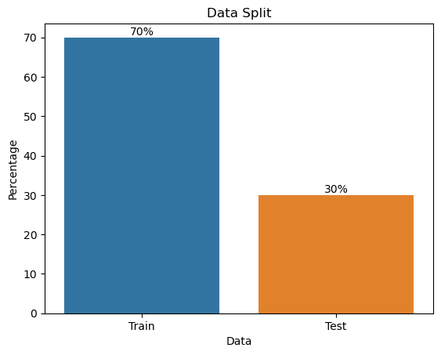

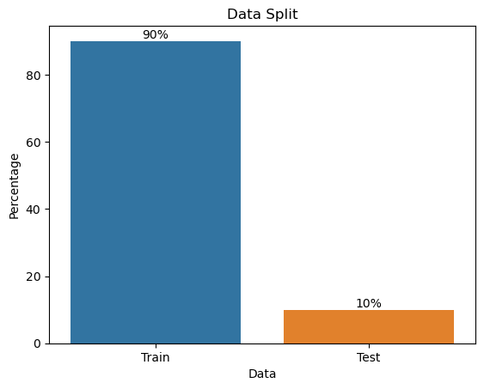
Train Test Split
Since our results were not ideal with lowest MAE being over 100k I thought maybe changing the way we split our data will help

Slide 23
Train Test Split
I evaluate the results of each of the split and the split ratio that provided the best result was the 90 – 10 split hence we would be using that from now on

Slide 24
Standardization
Back to the standardizer, previously I just used standard scaler as a placer holder to evaluate each model, however after testing multiple scalers and comparing them, It was shown that all the scaler’s scores were around the same with no scaler slightly winning by a small margin
so, I decided that no scaler would be best as Huber Regressor is less affected by outlier anyways

Slide 25
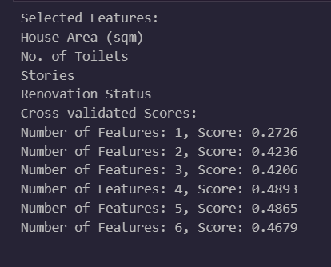
Feature Selection
I used RFECV which evaluate the score when keeping each feature and as the output shows, keeping 4 features was the best, as keeping any more features than that causes the score to drop. The features that it decides do keep is listed as well hence I just apply the chosen feature to my dataset to use from now on

Slide 26
Outlier Detection
For outliers although Huber Regressor is more robust and less affected by them, I decided to just remove them since I didn’t use any scaler as well
So, I removed outliers from House Area, and the target variable Price $ using Z-score method

Slide 27
Final Model

Slide 28
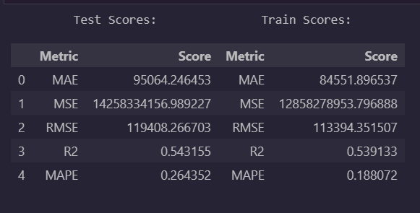
Final Model
With all that we done I evaluate the score of the final model, with a final MAE score it showing around 95k, which means in our context we can predict the price of a house with a 95k space for error I feel like that is a major improvement from the baseline model and not a bad score considering our dataset was relatively small

Slide 29
Thanks
Please keep this slide for attribution

